Slide 1
EMOTIONAL RESILIENCE & THE ANXIOUS STUDENT Part One ᷉ Supported by the Northwest Ohio Clinical Education Consortium
Deborah George, PT, PhD, MS,DCE
Allison Durham, PT, DPT, RN, DCE
Karyn Westrick, MA, LPCC-S

Slide 2
Objective
Demonstrate appreciation for the need to address student mental health issues, in particular anxiety.
Explain common behaviors exhibited by a student with anxiety.
Explain potential solutions to deal with the anxious situation, as recommended by the mental health counselor
Develop skill with providing a supportive approach to mentoring students during clinical education.
Notes:
Introduction & present objectives - AD

Slide 3
Evidence on Growth of Mental Health Issues
MILLENIALS: Ages 22 – 37 GEN Z: Ages 15 – 21
American Psychological Association, 2018 ¹
Notes:
AD

Slide 4
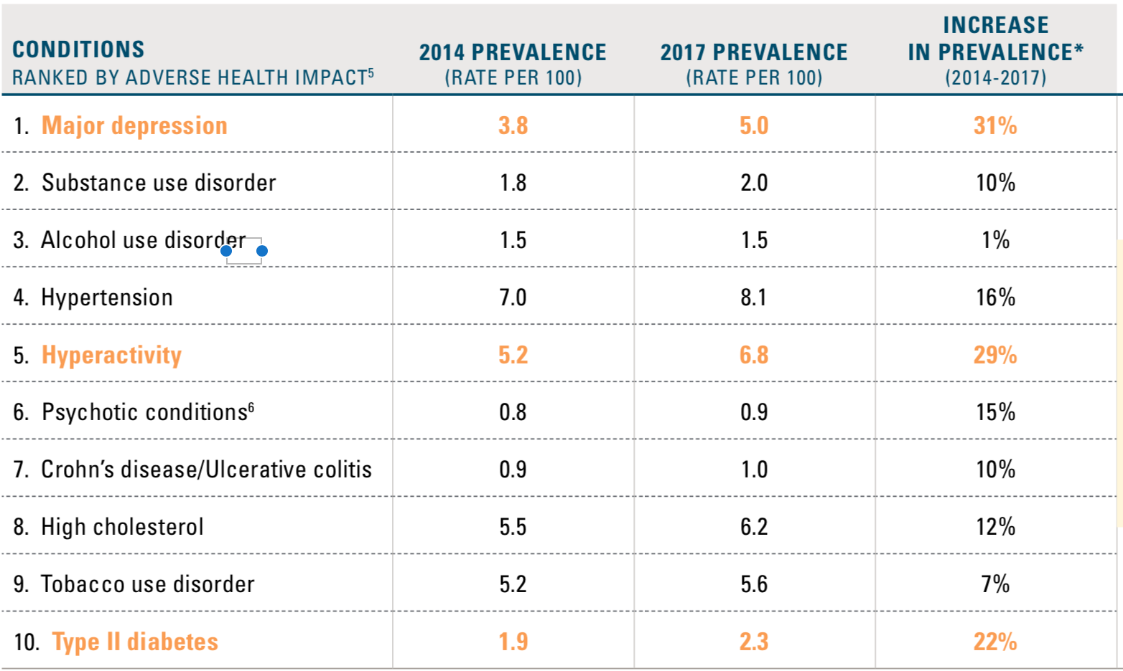
Evidence on Growth of Mental Health Issues
TOP 10 CONDITIONS AFFECTING MILLENNIALS AND PREVALENCE INCREASE
(AGES 21-36 IN 2017)
Blue Cross Blue Shield, The Health of Millennials, 2019 ²
Notes:
AD

Slide 5
Theories to Contribution of Rise in Student Stress
Social Media/Technology³
Constantly faced with negative news
Comparisons decreasing self esteem
Less human interaction leading to poor development of communication and socialization skills
“Lawnmower” Parenting⁴
Parents “mowing down” child’s conflicts and struggles
Leads to child not developing communication or problem solving skills
More acknowledgement of mental health awareness and needs⁵
More students seeking help
Increase in report of mental health issues
Notes:
AD

Slide 6
Response to Student Stress on the Rise
ACAPT Task Force to Enhance Academic Programs’ Awareness of the Mental Health and Wellness Needs of Students & Future Clinicians
The objectives of the task force:
Improve baseline understanding of challenges to student and clinician well-being
Raise the visibility of clinician stress and burnout
To provide tools, resources and/or programming related to this area including research areas
acapt.org/news⁶
Notes:
AD

Slide 7
Definitions
Anxiety: a basic human emotion, whereby the individual is apprehensive about uncertain outcomes.⁷
State Anxiety: anxiety due to a specific situation & has a trigger.⁷
Trait Anxiety: chronic, pervasive anxiety, not triggered by specific events.⁷
Resilience: the process by which people adapt to changes or crises which is not a character trait, but can be learned.⁸; “the ability to bounce back or cope successfully despite substantial adversity”⁹
Notes:
DG Common language

Slide 8
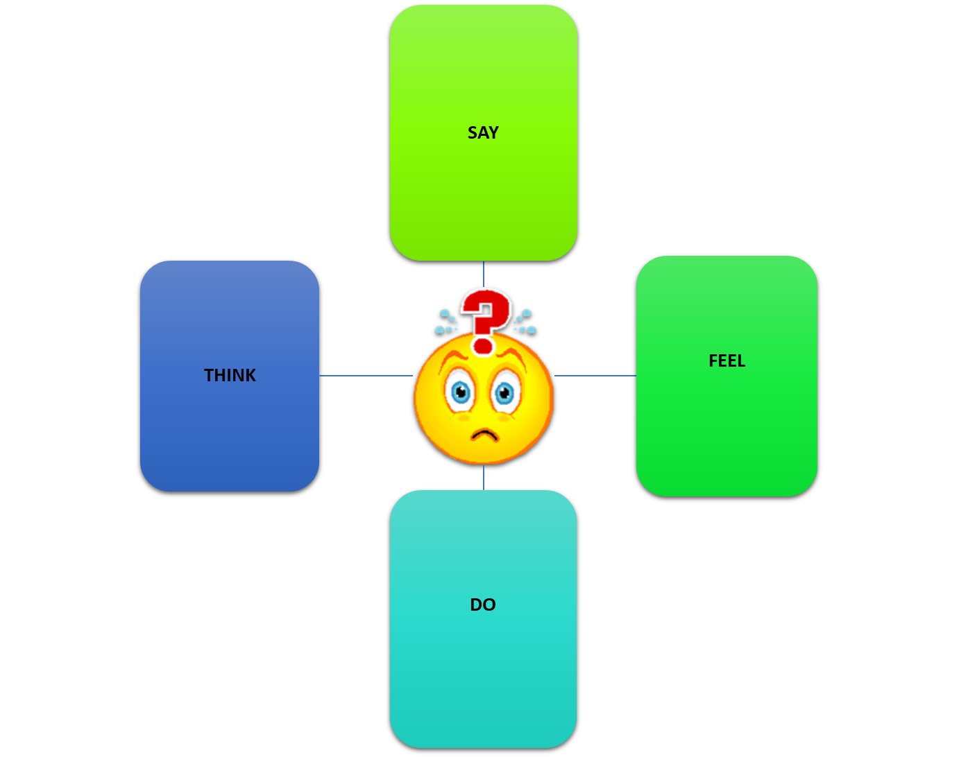
Who is the anxious student ?
SAY
"Ummm"
"I don't know it"
"Not sure"
"What do you think?"
FEEL
Panic
Fear
Uneasiness
Dread
Nausea
THINK
I'm not good enough
I'm stupid
I will FAIL
Mind goes blank
DO
Sweaty hands
S.O.B.
Dry mouth
Big eyes
Muscle tension
Notes:
DG

Slide 9
Who is the anxious DPT student ?
Appearance | Internal
Shy & timid, choosing to eat lunch alone | Desperately wanting to be part of the team; needs to be asked.
Repeating questions during hx taking & not being complete | Feeling overwhelmed with wanting to include every question
Taking excessive amounts of time for documentation | Trying to perfect the note & loosing sight of time
Focusing on the tubes rather than the patient | Fearful of harming the patient by pulling out the tubes
Lack of creativity with exercise programs | Mimicking the team’s approach to the exercises

Slide 10
Student Perspective – Stress Triggers
Notes:
AD

Slide 11
REFLECTION – Pause & think
What could the CI or SCCE do to help alleviate the stress in this particular student?
Notes:
AD

Slide 12
Student Perspective – Potential Solutions
Notes:
AD

Slide 13
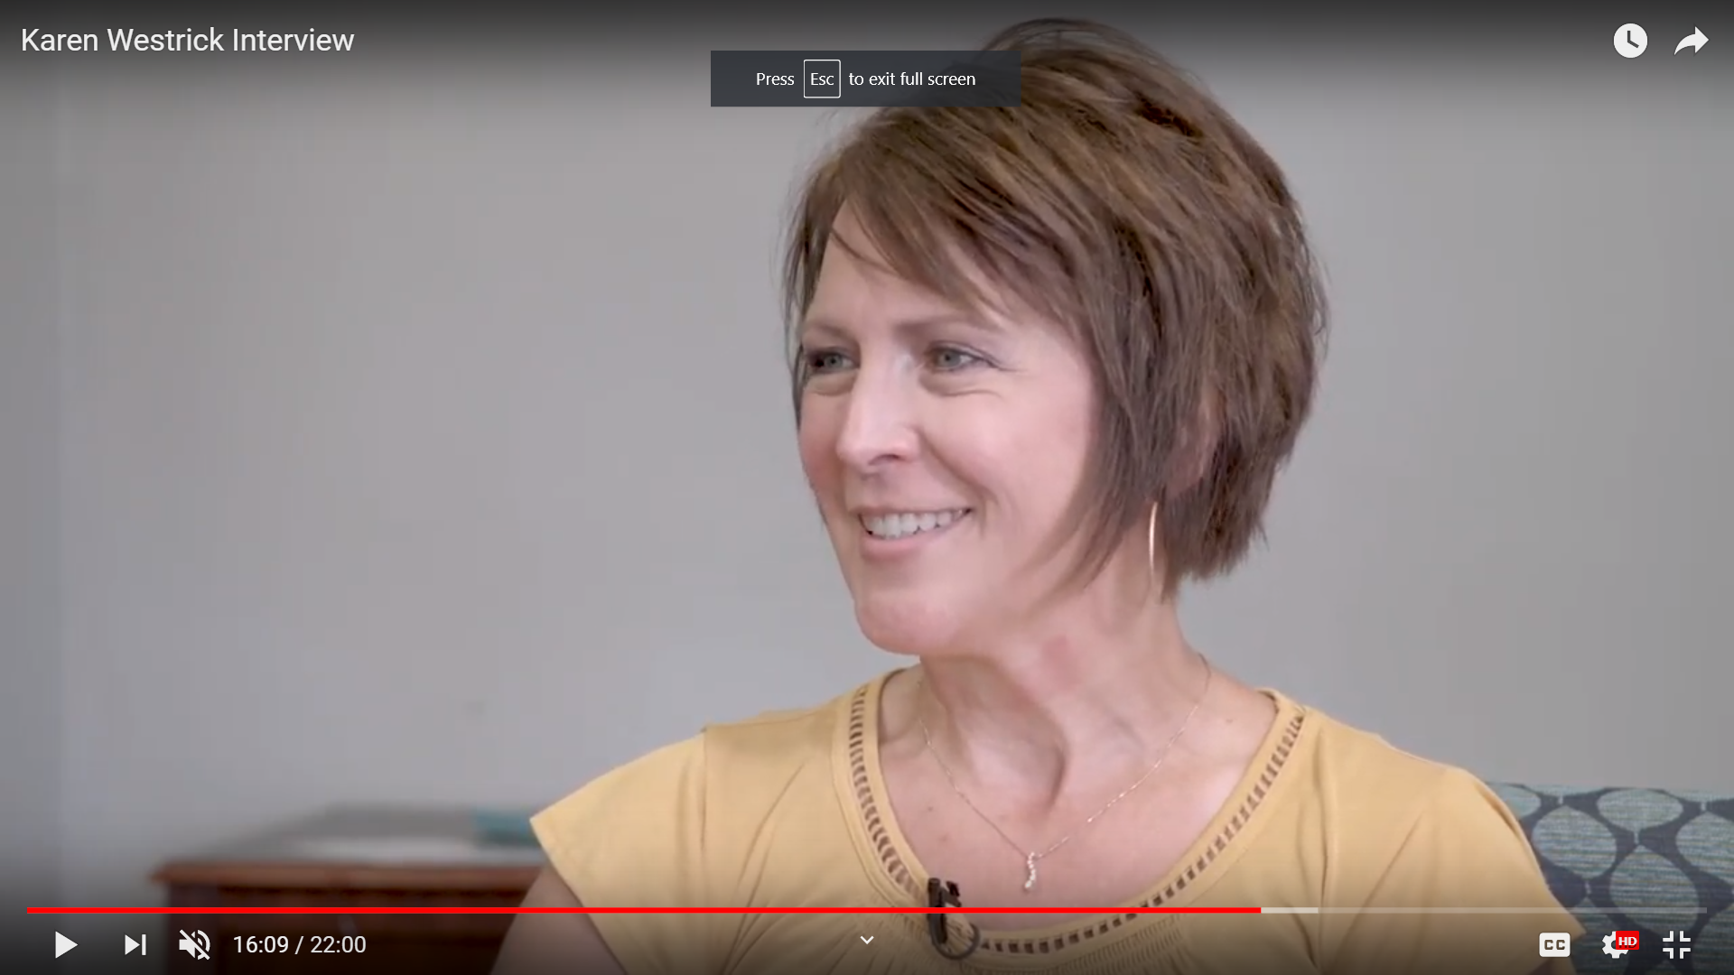
Mental health professional perspective
Interview with Karyn Westrick, MA, LPCC-S
https://youtu.be/MsiDfB9sNoQ
Notes:
BREAK and then DG

Slide 14
Take home message from the expert
Time
Space
Reassurance
Emotional Resilience
Notes:
DG

Slide 15
Responsibilities involve all parties ⁸⁻¹¹
Student | Clinical Educator
Know own limitations & abilities; weekly reflections | Learn limitations & abilities of the student; weekly reflections
Keep a positive view of self | Provide unconditional regard; be supportive
Maintain general health & well-being | Encourage self-care
Maintain of supportive relationships | Encourage supportive relationships; allow group interactions

Slide 16
Responsibilities involve all parties ⁸⁻¹¹
Student | Clinical Educator
Consider the situation & other’s perspectives | Consider the situation & student’s perspectives
Respect boundaries set by the CI & situation | Provide explanations & set boundaries
Utilize conflict resolution, appropriately | Promote conflict resolution strategies

Slide 17
Responsibilities involve all parties ⁸⁻¹¹
Student | Clinical Educator
Look at the big picture – take one day at a time and visualize what you want | Have realistic expectations & progress the student one day at a time
Come to terms with circumstances you cannot change | Work closely with all on unexpected circumstances

Slide 18
DCE Responsibilities
Readiness | Ongoing Support
Awareness of student Lab practicals Integrated Clinical Education Team meetings | Weekly reflections Midterm contact Learning contracts
Unconditional regard Allow choice of clinical site Send out own information packets | Open door policy – give cell phone If difficulty, check in periodically

Slide 19
DCE Responsibilities
Readiness | Ongoing Support
Health & well-being Team meetings Office of Accommodations & Inclusion (OAI) Counseling services | Reminders for self-care (nutrition, sleep etc.) Reminders for OAI & counseling
Supportive relationships Cohort activity Mentors Faculty support | Encouragement of supportive relationships

Slide 20
DCE Responsibilities
Readiness | Ongoing Support
Other’s perspectives Group activity – cases Integrated CE | Encouragement of viewing others perspectives
Boundaries Initial phone call to determine preparations Compliance of requirements | Expectation to review P&P Facilitate understanding

Slide 21
DCE Responsibilities
Readiness | Ongoing Support
Conflict resolution Accountability at university | Gain each individuals perspective then share
Realistic expectations-whole picture CPI training – student & CI Syllabi & communications hour | Syllabi & CPI criteria Extended clinical Remedial clinical

Slide 22
DCE Responsibilities
Readiness | Ongoing Support
Unexpected circumstances Attendance policy Communication | Delay or time out is allowed

Slide 23
Summary – We are a team ….
Student
CI
SCCE
DCE/ACCE
PROMOTE EMOTIONAL RESILIENCE
Notes:
DG

Slide 24
Part Two of this series
Emotional resilience, its antecedents, & consequences.
Role & functions of the Office of Accommodations & Inclusion
Strategies & a supportive approach to mentoring for clinical faculty

Slide 25
Questions ?
Contact information:
Deborah George - 419-434-5531 george@findlay.edu
Allison Durham – 419-434-5975
durham@findlay.edu
Notes:
DG finishes….

Slide 26
References
American Psychological Association (2018). Stress in America: Generation Z. Stress in AmericaTM Survey.
Blue Cross Blue Shield (2019). The Health of Millenials. The Health of America Report®.
Lepp A, Barkley JE, and Karpinski AC. The relationship between cell phone use, academic performance, anxiety, and Satisfaction with Life in college students. Computers in Human Behavior. 2014. 31: 343-350.
Haller S. Meet the 'lawnmower parent,' the new helicopter parents of 2018. USA Today. September 19, 2018. www.usatoday.com. Accessed July 29, 2019.
Oswalt SE, et al. Trends in college students’ mental health diagnoses and utilization of services, 2009–2015. J Am Coll Health, 2018; 25:1-11.
American Council of Academic Physical Therapy. https://acapt.org/news. Accessed June 18, 2019.
Hurberty T. Test and performance anxiety. Principal Leadership. 2009; 9:12-16.
Call JA. Resilience in the face of rough times. Psychology Today. July 9, 2008. http://www.psychologytoday.com. Accessed June 26, 2019.
Rutter M. Resilience in the face of adversity: Protective factors and resistance to psychiatric disorder. British Journal of Psychiatry, 1985; 147:598–611.
Earvolino-Ramirez M. Resilience: A concept analysis. Nursing Forum, 2007; 42(2): 73-82.
Dunn L., Iglewicz A., Moutier C. A conceptual model of medical student well-being: Promoting resilience and preventing burnout. Academic Psychiatry, 2008; 32: 44–53.

